Slide 1


Slide 2
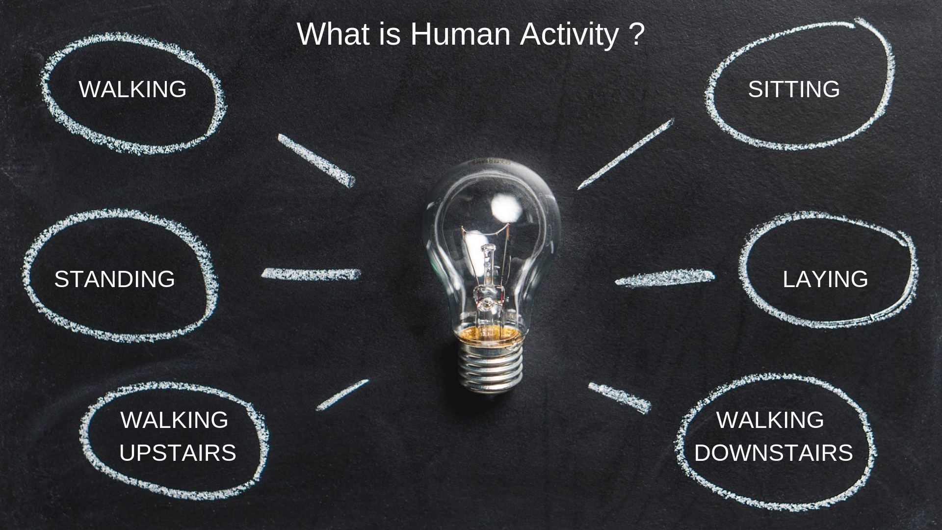

Slide 3
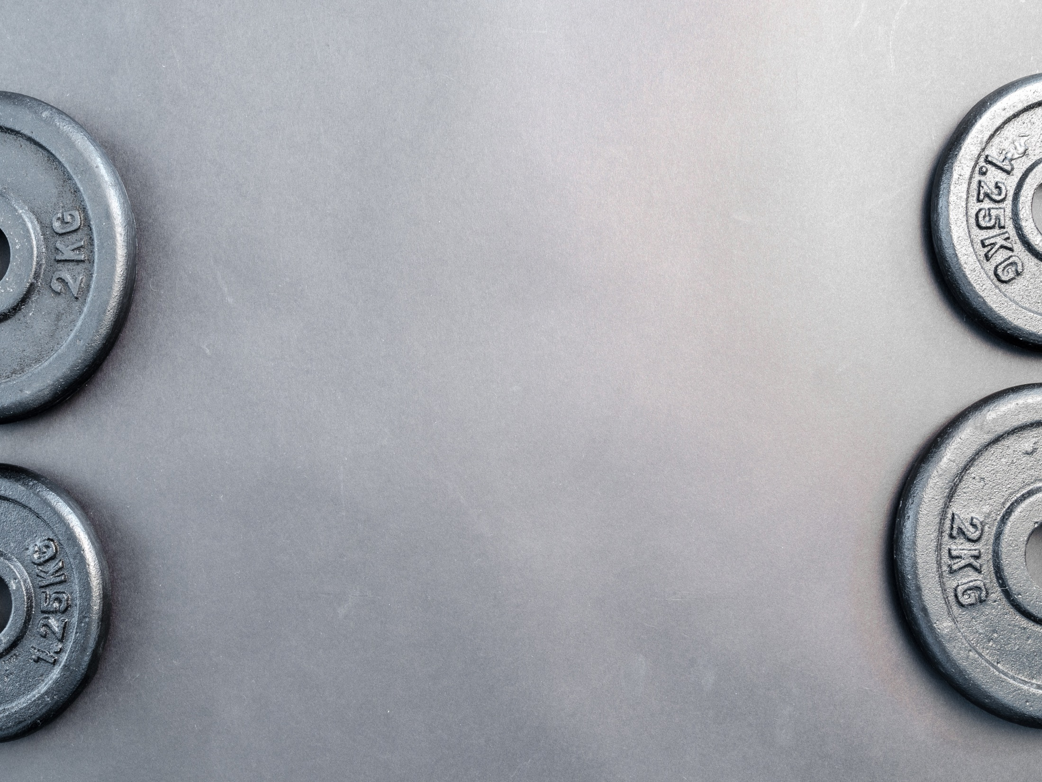
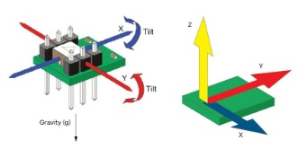
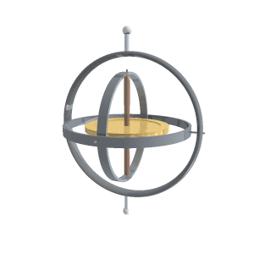
What Tools are used for measuring human activity ?
Accelerometer
Gyroscope
An accelerometer detects acceleration, vibration, and tilt to determine movement and exact orientation along the three axes.
Gyroscope also provides orientation details and direction like up/down and left/right but with greater precision like how much the device is tilted. This is where it differs from accelerometer.

Slide 4
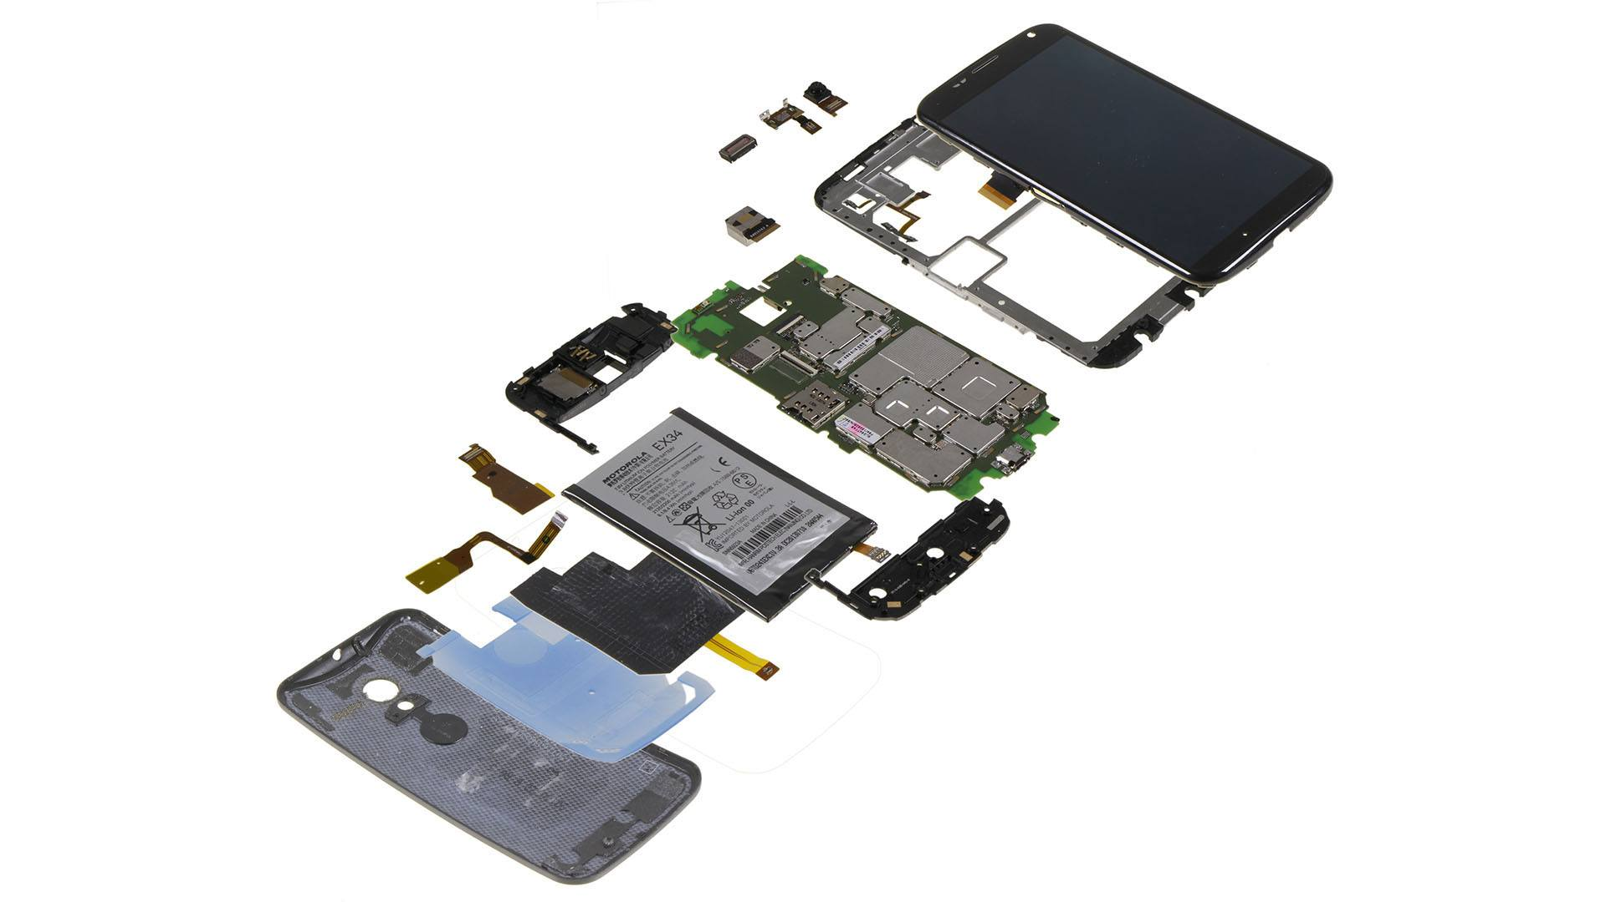
How does these sensors work in Mobile devices ?
Accelerometer
Smartphones and other mobile technology identify their orientation through the use of an accelerometers , a small device made up of axis-based motion sensing. The motion sensors in accelerometers can even be used to detect earthquakes, and may be used in medical devices such as bionic limbs and other artificial body parts.

Slide 5
How does these sensors work in Mobile devices ?
Gyroscope
Accelerometers in mobile phones are used to detect the orientation of the phone. The gyroscope, or gyro for short, adds an additional dimension to the information supplied by the accelerometer by tracking rotation or twist.

Slide 6
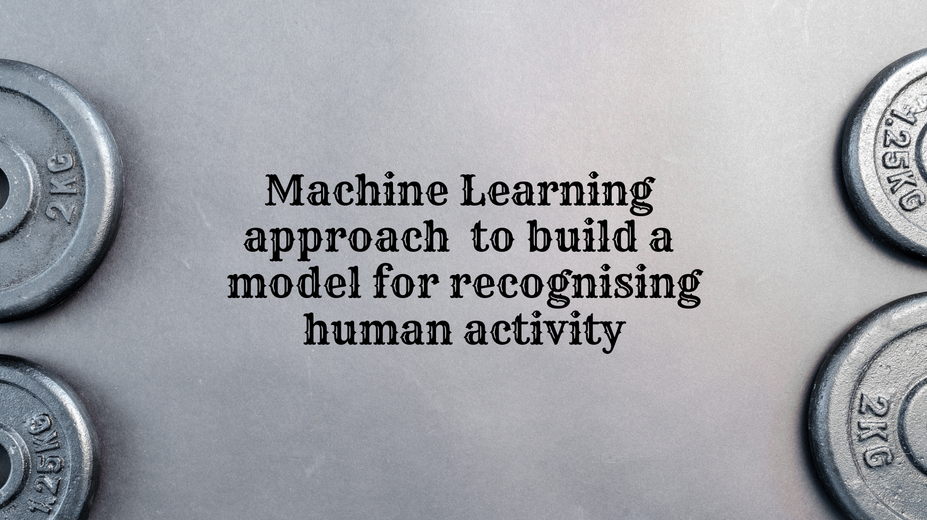
Exploratory Data Analysis - EDA
Data Profiling
Building Machine Learning Model
Dimensionality Reduction
Conclusion and Reference
Model Selection

Slide 7

Understanding the Dataset
Processing
Skew and Kurt
Correlation

Slide 8
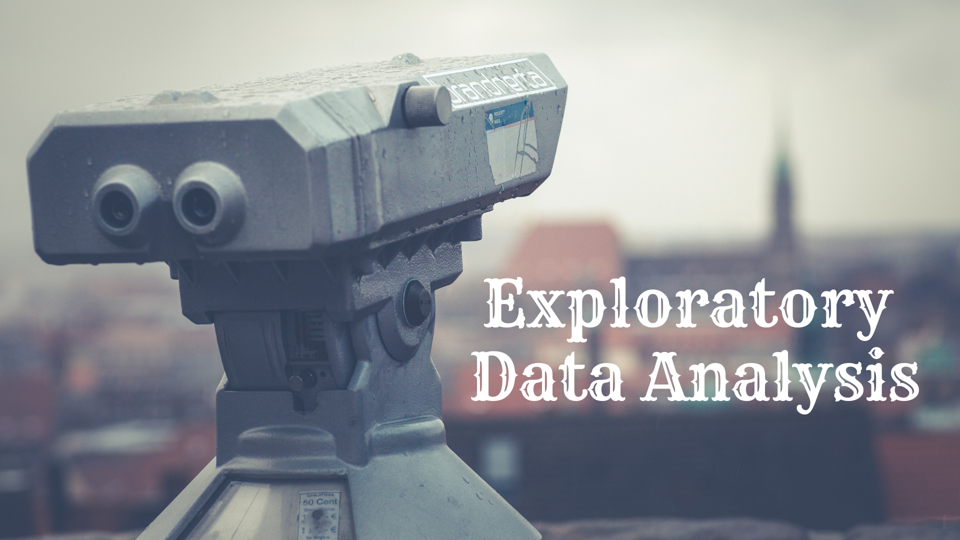
Univariate Analysis
Correlation
Multicollinearity

Slide 9
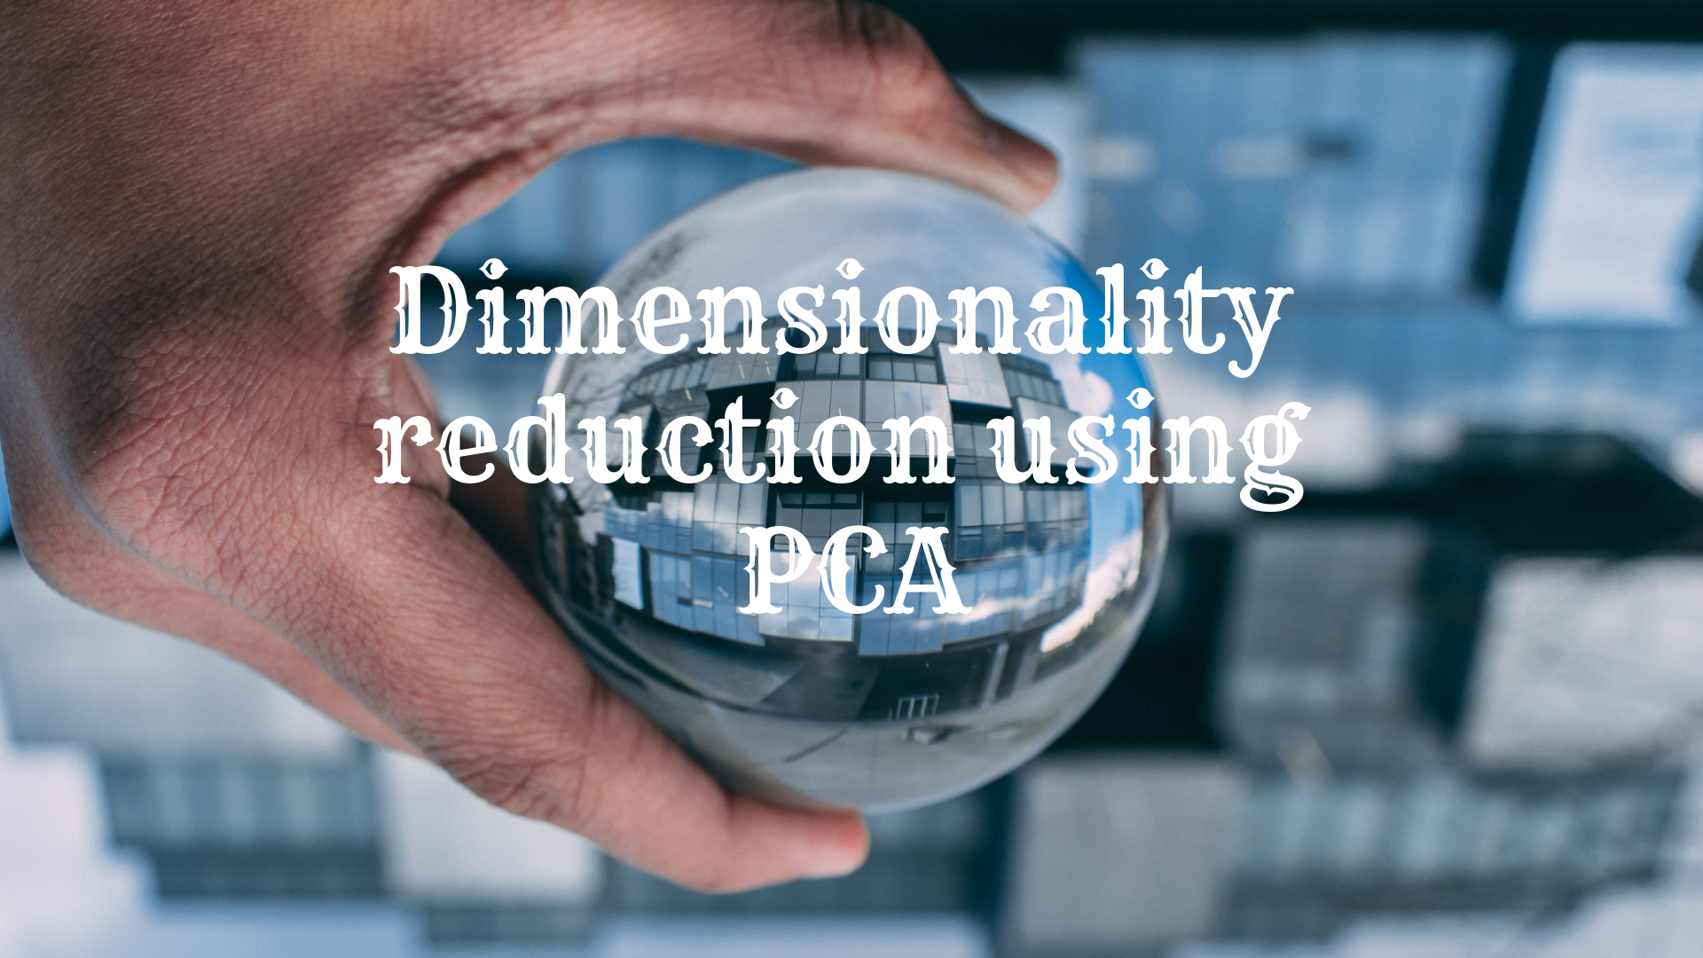
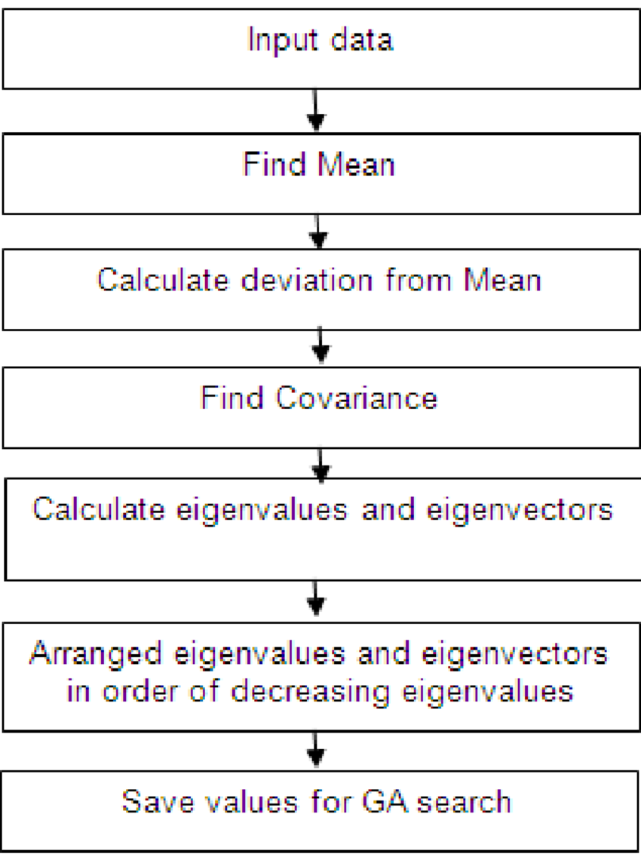
PCA is one of the method to reduce the dimensionality of a data set.

Slide 10
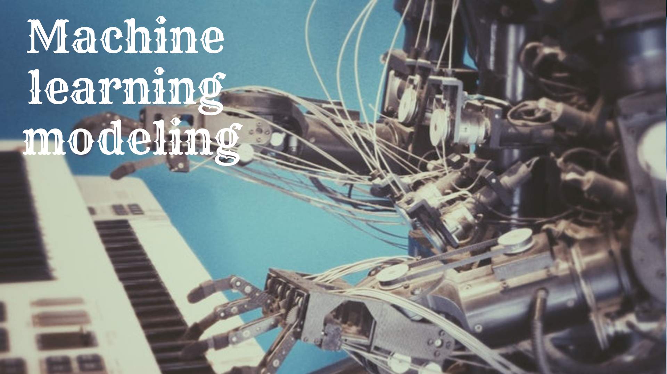
I have used the following Algorithms
Decision Tree classifier
Logistic Regression
Random Forest classifier
KNN K-Nearest Neighbour
Naive Bayes classifier
Support Vector Machine (SVM)

Slide 11
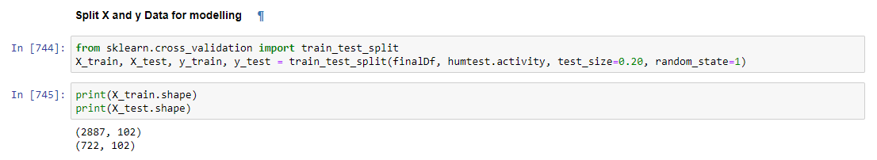
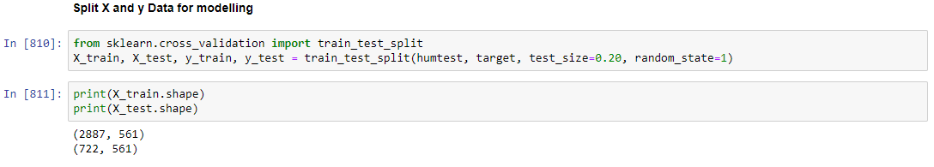
Worked on two sets of Data – PCA and Complete Data set
PCA data contains 102 attributes :
The other data set has all of its attributes with 561 columns:

Slide 12

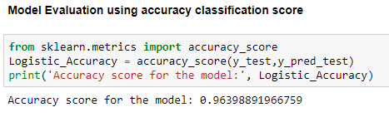

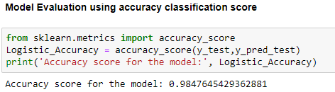
Logistic Regression
Accuracy score of Logistic regression on both the data set.
PCA Data set :
Complete Data set:

Slide 13

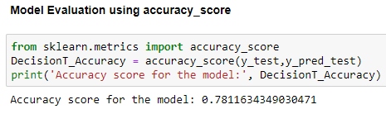

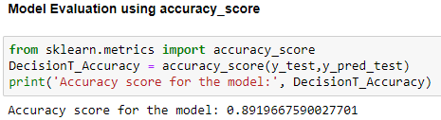
Decision Tree classifier
Accuracy score of Decision Tree classifier on both the data set.
PCA Data set :
Complete Data set:

Slide 14

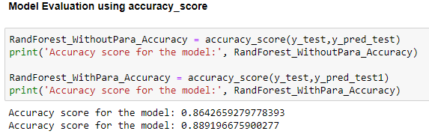
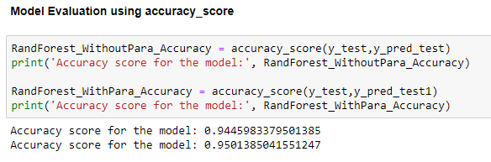

Random Forest classifier
Accuracy score of Random Forest classifier on both the data set.
PCA Data set :
Complete Data set:

Slide 15

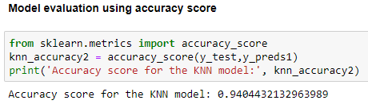
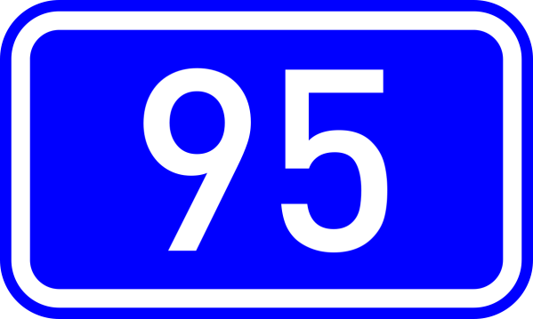
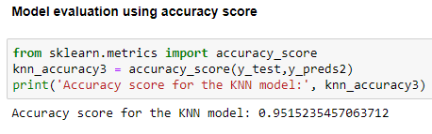
KNN K-Nearest Neighbour
Accuracy score of KNN K-Nearest Neighbour on both the data set.
PCA Data set :
Complete Data set:

Slide 16
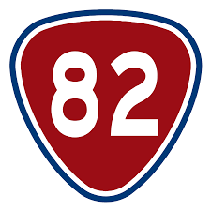
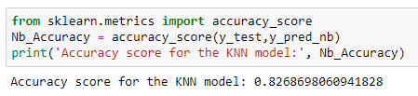
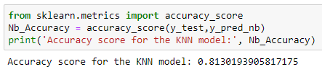

Naive Bayes classifier
Accuracy score of Naive Bayes classifier on both the data set.
PCA Data set :
Complete Data set:

Slide 17
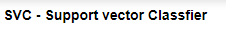
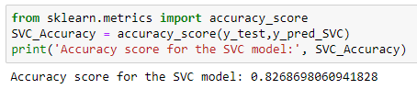

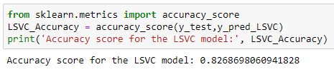
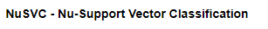
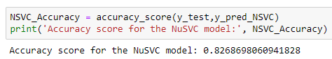
SVM - Support Vector Machines
Accuracy score of SVM - Support Vector Machines on both the data set.
PCA Data set :

Slide 18
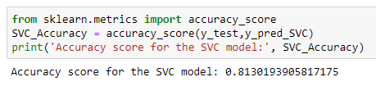

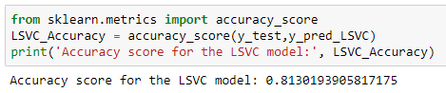
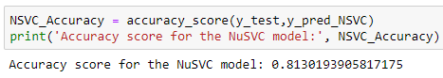
Complete Data set:

Slide 19
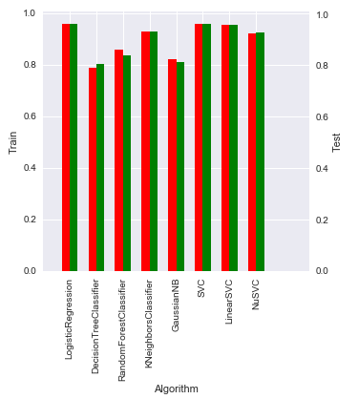
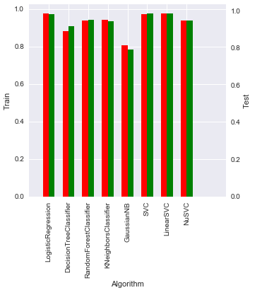
Accuracy comparison between PCA and Complete data set
PCA Data set :
Complete Data set:
Red line display Training data accuracy and green display Test data accuracy

Slide 20
Conclusion
ML projects are inherently uncertain and the approach i have used is accountable for hitting a specific accuracy goal.
I have performed error analysis for each model, I have tried to tune the models to get accurate results.
I have tried to implement all of my ideas as much as possible. I have done some trial and error to see how it works.
I have explored and performed Data Analysis and Data Cleaning to build my ML Model as accurate as possible.
Things which i have not performed in depth is Handling Outliers, GridSearch (due to large input variables).
Overall the Model looks good and Logistic Regression has given 98.47% accuracy and KNN has given 95% accuracy.

Slide 21


